Slide 1
C PROGRAM FOR MATRIX OPERATIONS:
ADDITION
SUBRACTION
MULTIPLICATION
DIVISION
DETERMIANT
AT GITHUB LINK:
https://github.com/afsalJ/Cprograms/blob/1419bcc6370615a53707b5a6ca83a7608f6542f2/Matrix%20Operation%20Program/MatrixAdd.c

Slide 2
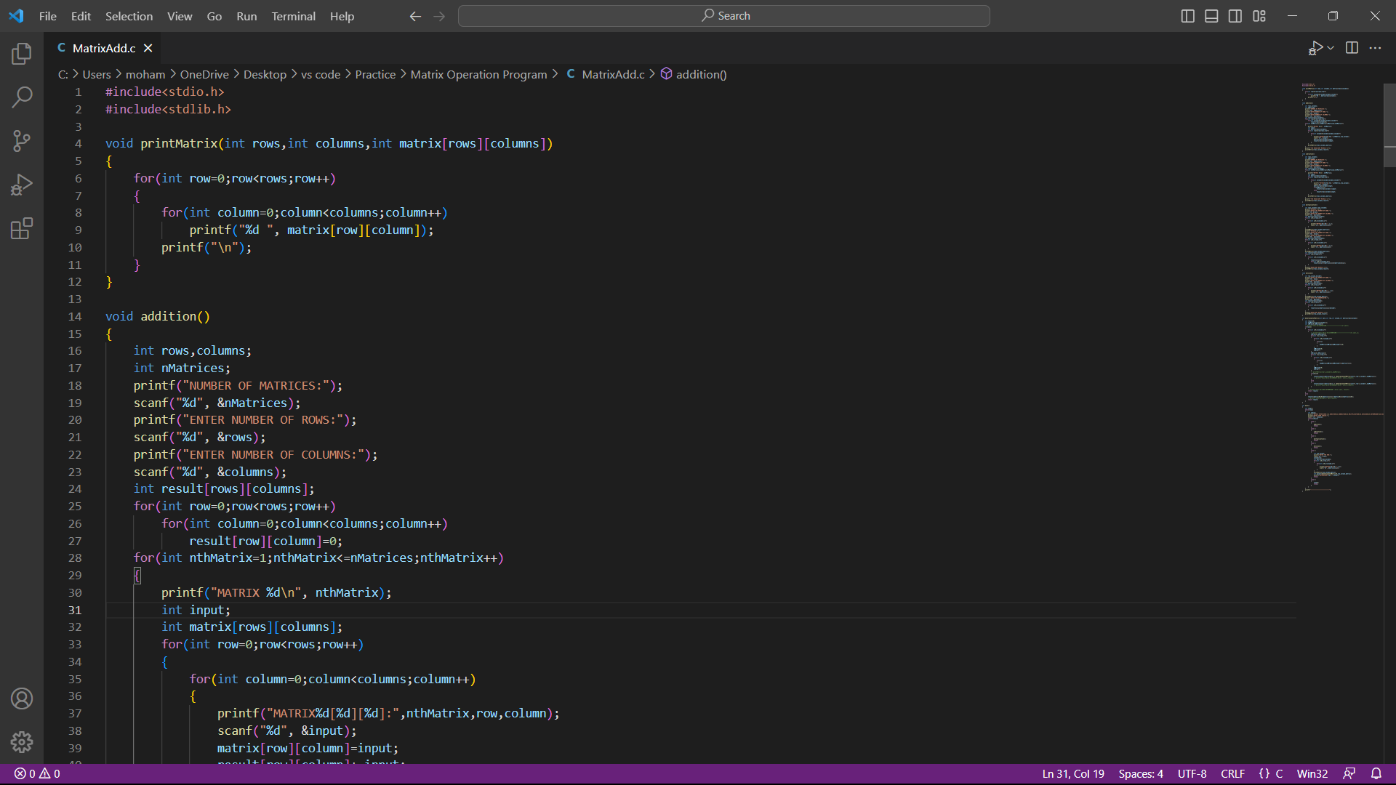
THE SAMPLE

